Slide 1




NCDA Winter Conference
February 2026
Executive Orders and Agreement Addendums
City of Monterey, CA

Slide 2
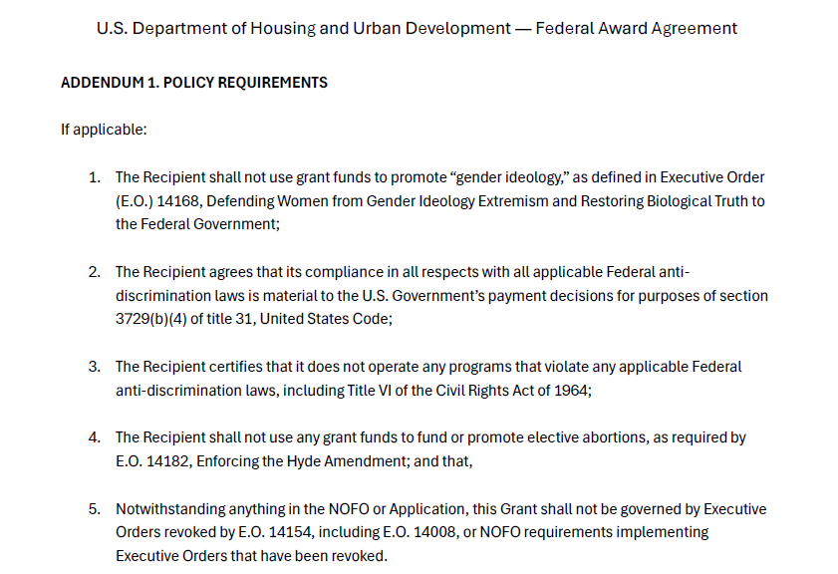

Slide 3
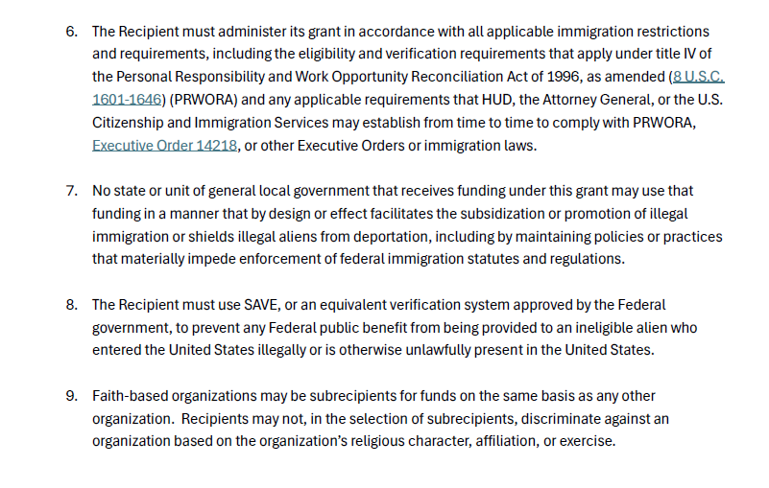
Addendum 1 continued

Slide 4
Executive orders
NCDA Guidance on EOs
Clause 1: Prohibition on Promotion of Gender Ideology Source: Executive Order 14168, Defending Women from Gender Ideology Extremism and Restoring Biological Truth to the Federal Government
Clauses 2 & 3: Civil Rights Compliance and the False Claims Act Sources: Clause 2 (31 U.S.C. § 3729, False Claims Act) and Clause 3 (Executive Order 14173, Prohibiting Discrimination Based on Race, Color, Sex, Religion, or National Origin in Federal Programs)
Clause 4: Prohibition on Use of Funds for Elective Abortions Source: Executive Order 14182, Enforcing the Hyde Amendment
Clause 5: Climate and NEPA Source: Executive Order 14154, Energy Independence and Regulatory Reform
Clause 6: PRWORA and Immigration Verification Sources: Personal Responsibility and Work Opportunity Reconciliation Act of 1996 (8 U.S.C. §§ 1601–1646); Executive Order 14218 (Ending Taxpayer Subsidization of Open Borders); July 11, 2025 Attorney General Order (90 FR 32023); 8 U.S.C. § 1642(d); 62 FR 61344
Clause 7: Sanctuary Restrictions Source: Executive Order 14218
Clause 8: Systematic Alien Verification for Entitlements (SAVE) Requirements
Clause 9: Faith-Based Organizations Executive Order 14205 (Establishment of the White House Faith Office), building on prior E.O.s 13199 (Bush), 13559 (Obama), and 13831 (Trump, amended 2025)

Slide 5
Executive orders/NCDA Guidance
HUD is looking closely at a grantee’s conformity with applicable Administration policies and executive orders.
HUD Review on Conformity which means that a grantee:
1) Shall not use grant funds to promote “gender identity” as defined in EO 14168, Defending Women form Gender Ideology Extremism and Restoring Biological Truth to the Federal Government;
2) Agrees that its compliance in all respects with all applicable Federal anti- discrimination laws is material to the U.S. Government’s payment decisions;
3) Certifies it does not operate any programs that violate any applicable Federal discrimination laws, including Title VI (prohibits discrimination on the basis of race, color, or national origin in any program or activity receiving federal assistance).

Slide 6
CPD Programs Federal Public benefit
HUD clarified that CDBG program and other HUD CPD programs are federal public benefits under the definition in the Personal Responsibility and Work Opportunity Reconciliation Act of (1996) (PRWORA) and therefore subject to immigration verification requirements for eligibility.
The Systemic Alien Verification for Entitlements (SAVE) system is a tool for grantees to verify the immigration status of program beneficiaries.

Slide 7
Conformity
Must administer grant in accordance with all applicable immigration restrictions and requirements, including the eligibility and verification requirements that apply under Title IV of the Personal Responsibility and Work Opportunity Reconciliation Act of 1996 as amended and any other requirement that HUD, the Attorney General, or the U.S. Citizenship and Immigration Services may establish from time to time to comply with E.O., 14218, Ending Taxpayer Subsidization of Open Border, or other E.O.s or immigration laws.

Slide 8
Conformity
May not use grant funds in a manner that by design or effect facilitates the subsidization or promotion of illegal immigration or abets policies that seek to shield illegal aliens from deportation;
Must use SAVE –or approved equivalent verification system – for determining a noncitizen applicant’s eligibility for benefits;
May not discriminate against a faith-based organization based on its religious character, affiliation, or exercise.

Slide 9

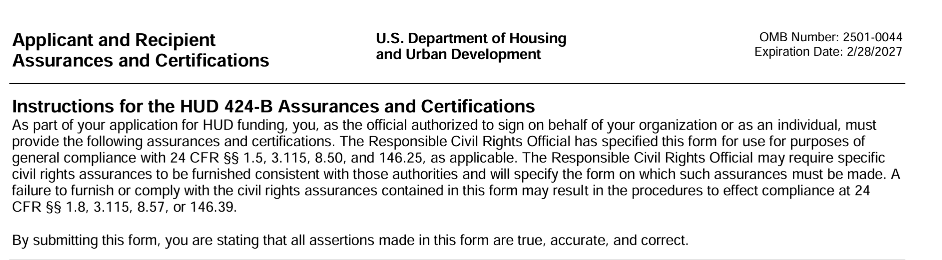
Cpd notice 25-02

Slide 10
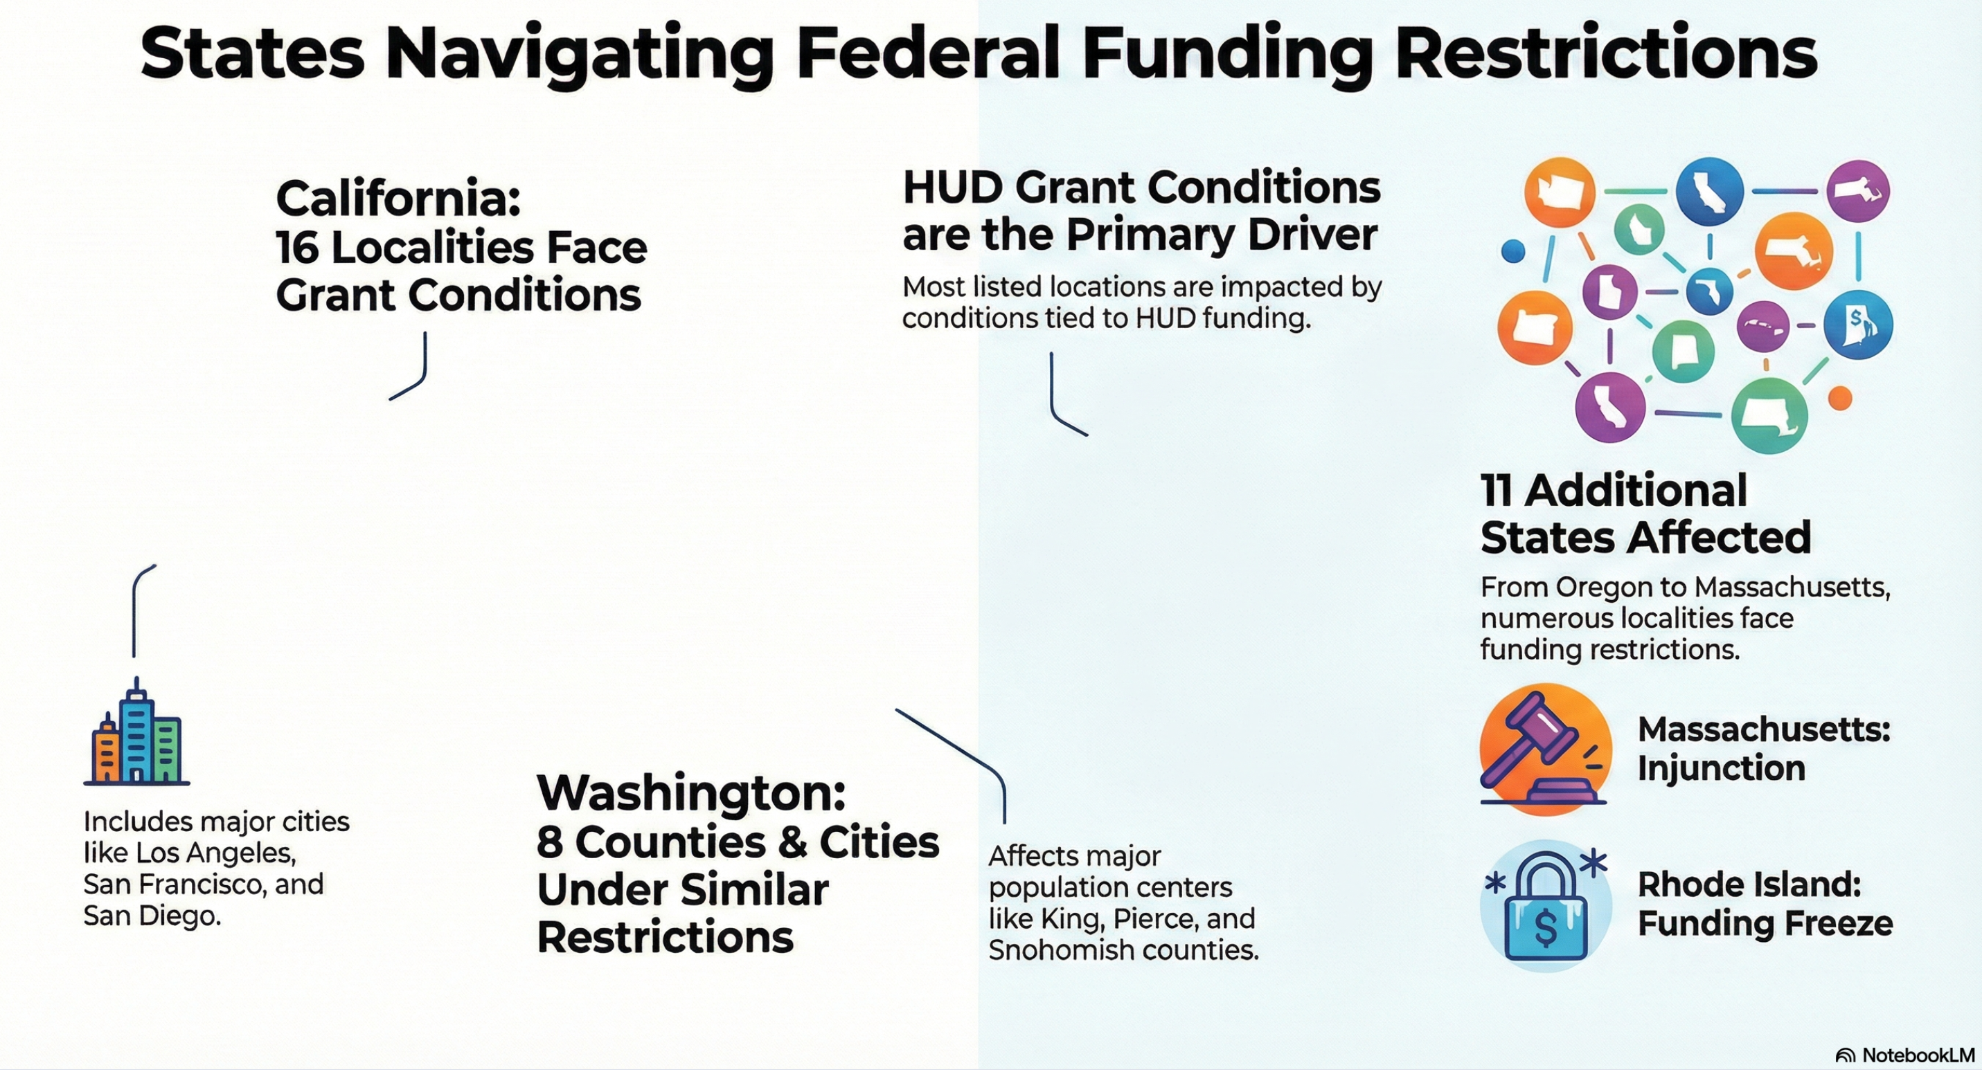
Injunctions on executive orders
Notes:
Various municipalities and counties across several U.S. states that have secured legal injunctions or specific protections regarding federal funding. These legal measures primarily target restrictions tied to HUD grants, ensuring that local governments maintain access to essential financial resources. There is a widespread effort by urban centers to challenge conditions imposed on the CDBG program. Federal grant conditions have been formally contested or frozen in these states.

Slide 11
How eo’s pertain to cdbg programs
HUD form 2516 (MBE/WBE) and Section 3
Not on HUD website
Should you submit to your HUD rep?
Complete on an old form and do not formally submit? You have data for the record.
Submit to general HUD email?

Slide 12
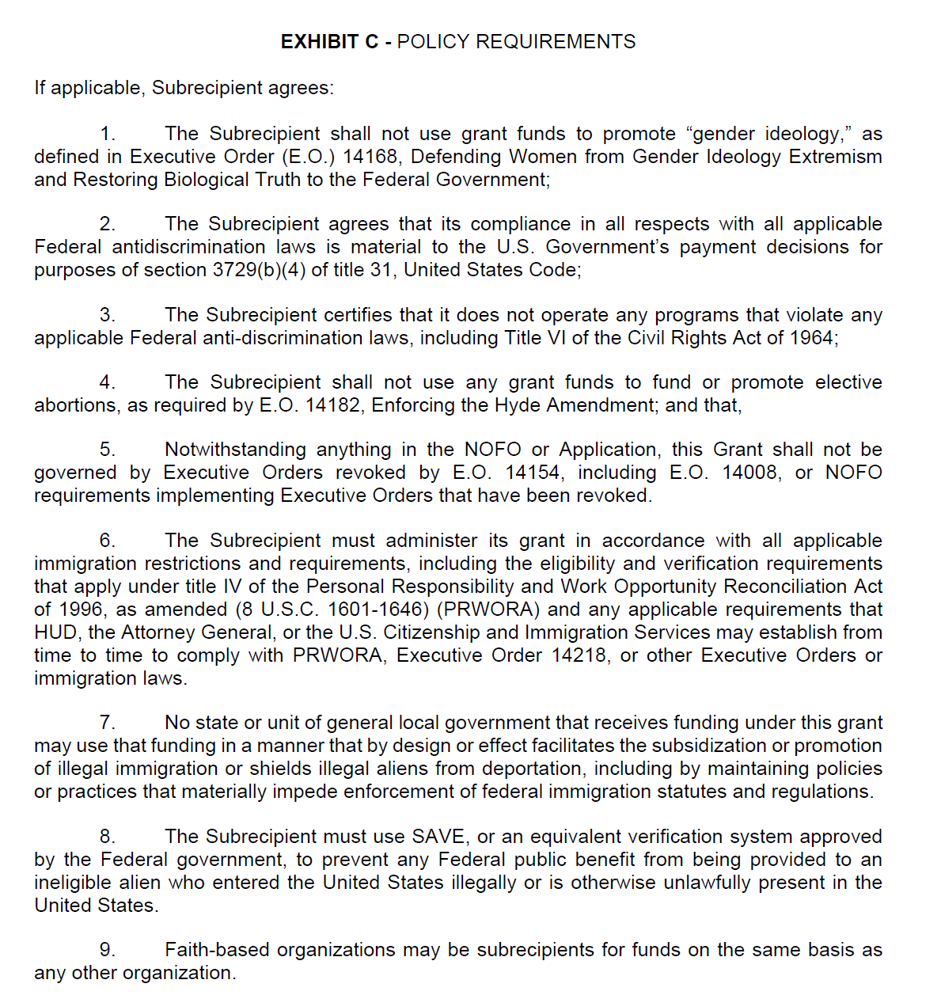
City of monterey

Slide 13
Dear Grantee,
This message serves as notification that the Department is questioning the accuracy of the City of Monterey’s certification that the Community Development Block Grant (CDBG) funds described in its Fiscal Year 2025 Consolidated Plan/Action Plan (the Plan) will be administered in conformity with applicable laws, including Executive Orders. HUD is providing this opportunity for your jurisdiction to comment (i.e., provide specific evidence demonstrating compliance with the certification) by responding to this notification. The grantee’s demonstration of the accuracy of its certification should include taking the actions described below by 5:00 pm EDT, Thursday, July 24, 2025. Failure to address HUD’s concerns regarding the certification may result in HUD determining that the certification is inaccurate or unsatisfactory, which will result in disapproval of the Plan.
During HUD’s review of the Fiscal Year 2025 Consolidated Plan/Action Plan submitted by your jurisdiction, the Department identified language in the Plan that appears to be inconsistent with Executive Order 14151 Ending Radical and Wasteful Government DEI Programs and Preferencing, and Executive Order 14173 Ending Illegal Discrimination and Restoring Merit-Based Opportunity, and Executive Order 14168 Defending Women From Gender Ideology Extremism and Restoring Biological Truth to the Federal Government. Specifically, the jurisdiction’s Plan states the following:
Page 56: Overall in the County, 77 percent of individuals experiencing homelessness were unsheltered and sleeping in streets, abandoned buildings, vehicles, encampment areas, or other similar locations. The sheltered population was living in emergency shelters or transitional housing, which does not include people living in permanent supportive housing or participating in rapid rehousing programs. Countywide 66 percent of people experiencing homelessness were male, 32 percent were female, and 1 percent were transgender.” (page 56, emphasis added)
Page 82: “Increase participation in homeless solutions by leaders and key stakeholders across the region Adopt a five-year plan Invest strategically Build political will for affordable housing Include people with lived experience of homelessness Engage new partners Center equity” (page 82, emphasis added)

Slide 14
This language includes provisions that appear to be inconsistent with the implementation of federal programs pursuant to the referenced executive orders. To address this issue, your jurisdiction should provide assurance to the Department by taking the following actions:
Removing or replacing all “equity,” “inclusion” and DEI references throughout the document and replace with “activities and actions that do not violate any applicable Federal anti-discrimination laws, including Title VI of the Civil Rights Act of 1964” ;
Removing all “transgender” references throughout the document; and
Provide the following assurance statements within the Plan:
“The City of Monterey agrees that its compliance in all respects with all applicable Federal anti-discrimination laws is material to the U.S. Government’s payment decisions for purposes of section 3729(b)(4) of title 31, United States Code.”
“The City of Monterey will not operate any programs that violate any applicable Federal anti-discrimination laws, including Title VI of the Civil Rights Act of 1964.”
“The City of Monterey shall not use grant funds to promote “gender ideology,” as defined in Executive Order (E.O.) 14168, Defending Women from Gender Ideology Extremism and Restoring Biological Truth to the Federal Government.”
The grantee should re-submit the Plan to HUD by the deadline noted above. Please work to revise and resubmit your Plan in HUD’s Integrated Disbursement and Information System (IDIS) and reply to this message indicating that you have re-submitted the plan in IDIS. You are welcome to provide in your email response the section or page that contains the assurance statements. If HUD disapproves the Plan, the grantee must resubmit its Plan within 45 days after first notification of Plan disapproval (see 24 CFR 91.500(d)).

Slide 15
Surprise, arizona
Projects in Surprise are straightforward. They are not targeting or excluding populations. All beneficiaries are confirmed to be LMI.
Their Subrecipient Agreement states:
Suspension or Termination: In accordance with 2 CFR 200, the Grantee may suspend or terminate this Agreement if the Subrecipient materially fails to comply with any terms of this Agreement, which include (but are not limited to) the following:
Failure to comply with any of the rules, regulations, or provisions referred to herein, or such statutes, regulations, executive orders, and HUD guidelines, policies, or directives as may become applicable at any time.

Slide 16
Surprise Continued
HUD required Surprise to add the following statements to their AAP and added them to their agreement.
The Subrecipient agrees that its compliance in all respects with all applicable Federal anti-discrimination laws is material to the U.S. Government’s payment decisions for purposes of section 3729(b)(4) of title 31, United States Code.
The Subrecipient will not operate any programs that violate any applicable Federal anti-discrimination laws, including Title VI of the Civil Rights Act of 1964.

Slide 17
Surprise MBE/WBE Language
Surprise has added this to their MBE/WBE section:
The Subrecipient will comply with Executive Orders 14151 and 14173 when carrying out activities.
EO 14151: Ending Radical and Wasteful Government DEI Programs and Preferencing
EO 14173: Eliminating Unlawful DEI Programs in Federal Operations

Slide 18
Pasadena, california
Crossed out references to Executive Orders
Currently in a lawsuit with HUD

Slide 19

Communicating with hud rep

Slide 20
Grantees can
Follow statutory and regulatory requirements.
• Document every interpretive decision.
• Consult local counsel when conflicts arise between federal and state law.
• Communicate proactively with HUD Field Offices and retain written correspondence.

Slide 21
What immediate steps should grantees take?
Identify affected activities. Map all current and planned CDBG projects against each Addendum clause.
• Update agreements. Revise subrecipient and contractor templates to include Addendum 1 compliance language.
• Review policies. Update internal policies, procedures, and workflows to address PRWORA verification, recordkeeping, and communication standards.
• Train staff and subrecipients. Provide briefings on Addendum 1 requirements, focusing on documentation, eligibility, and communication controls.
• Document good-faith compliance. Maintain a record of every step taken to implement Addendum 1 while awaiting HUD guidance.
• Establish a centralized Addendum 1 tracking log to record all HUD communications and local interpretations.

Slide 22
Moving forward
Best defense for grantees is to demonstrate good-faith effort, transparency, and thorough documentation of all decisions
Or….. Listen to the next presentation
Let’s support each other through NCDA and get through this together!

